Slide 1
Data Science and Computer Programming Final Project: John Wick’s Kills Data
By: 李美娉 40747049s & 許鳳芹 40947063s

Slide 2
Table of Content
Data source
Objectives
Code
Result

Slide 3
Data Source
1
Where do we get the data from?

Slide 4
Data Source
The data is about the list of kills that the character John Wick made from the three movies:
John Wick
John Wick: Chapter 2
John Wick Chapter 3: Parabellum
Link : https://www.kaggle.com/datasets/zbowders/john-wicks-confirmed-onscreen-kills

Slide 5
Objectives
2
What are the questions that we want answered?

Slide 6
Objectives
How many kills are in each movie?
What is the most used weapon?
Who are the target/victims?

Slide 7
Code
3
Our python code

Slide 8
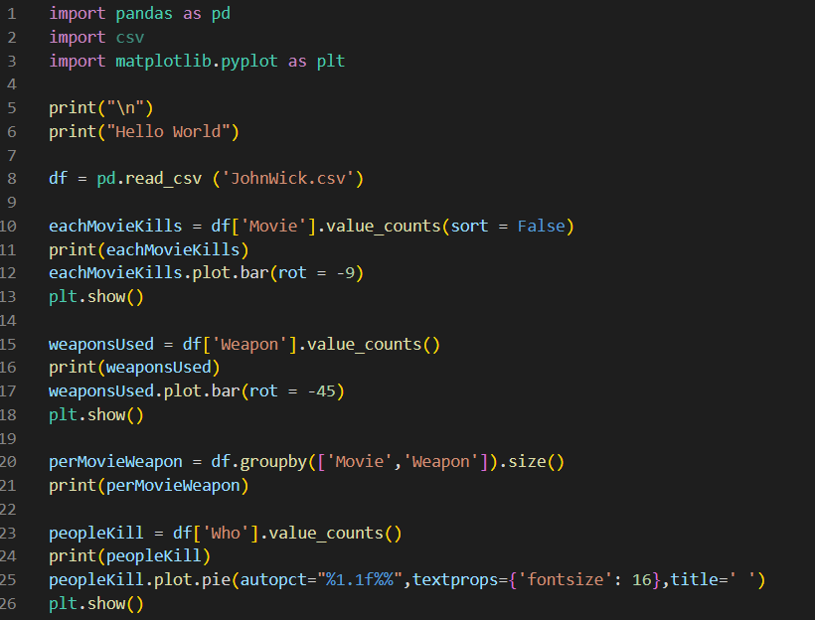
Code
Read csv

Slide 9

Code
# of kills each movie

Slide 10
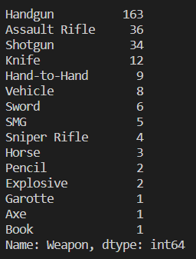
Code
#of weapon used

Slide 11
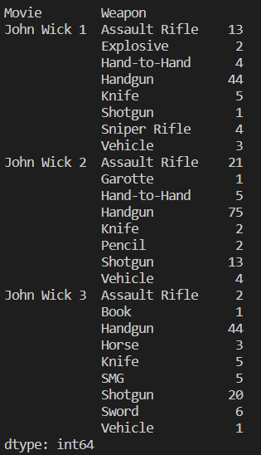
Code
#of weapon used each movie
(not part of objective)

Slide 12
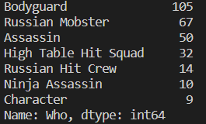
Code
Who are the target/victims?

Slide 13
Result
4
Result graphs

Slide 14
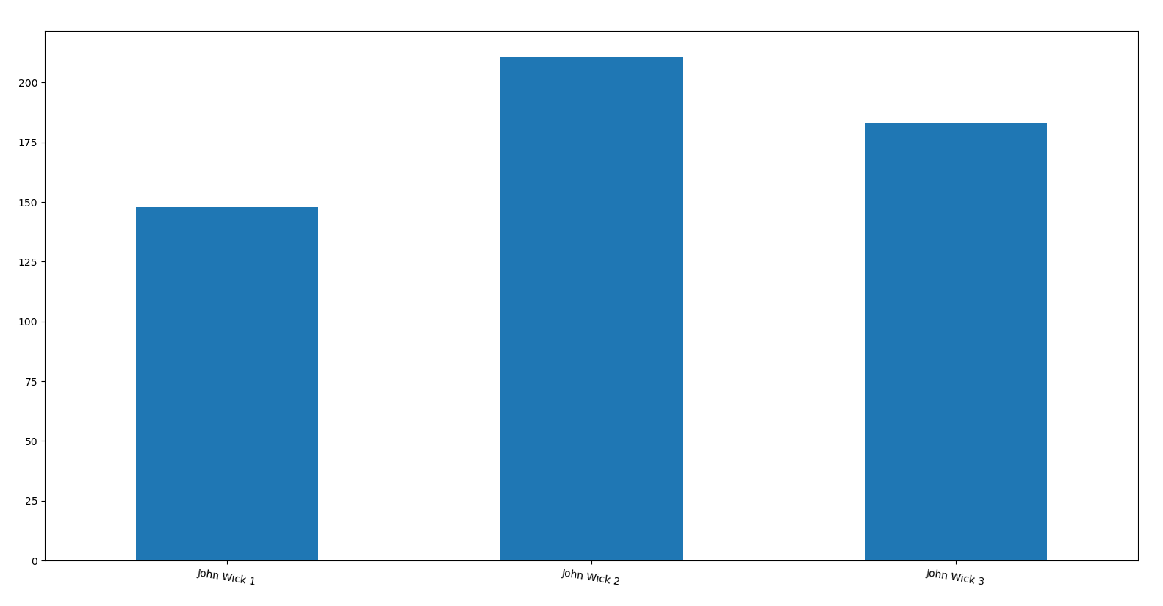
How many kills are in each movie?

Slide 15
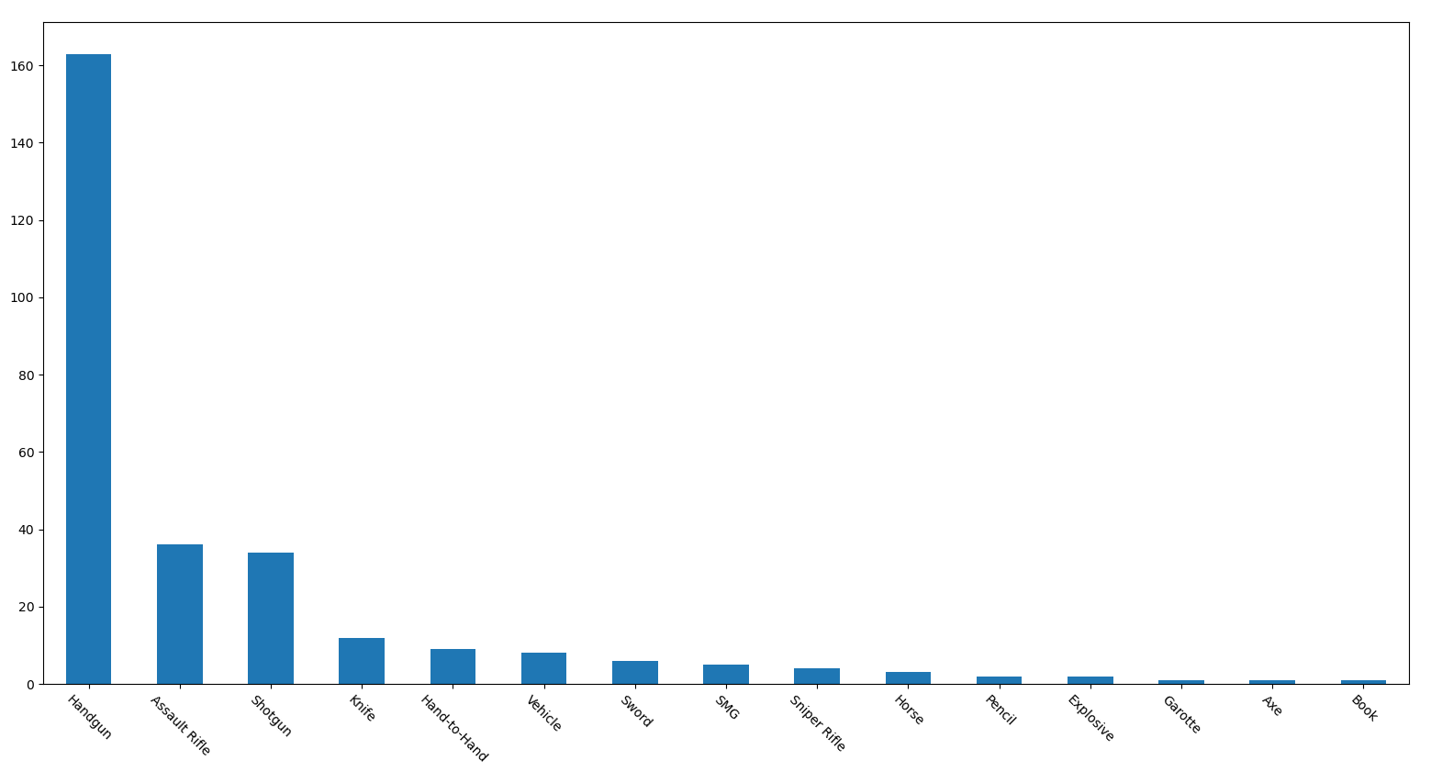
What is the most used weapon?

Slide 16
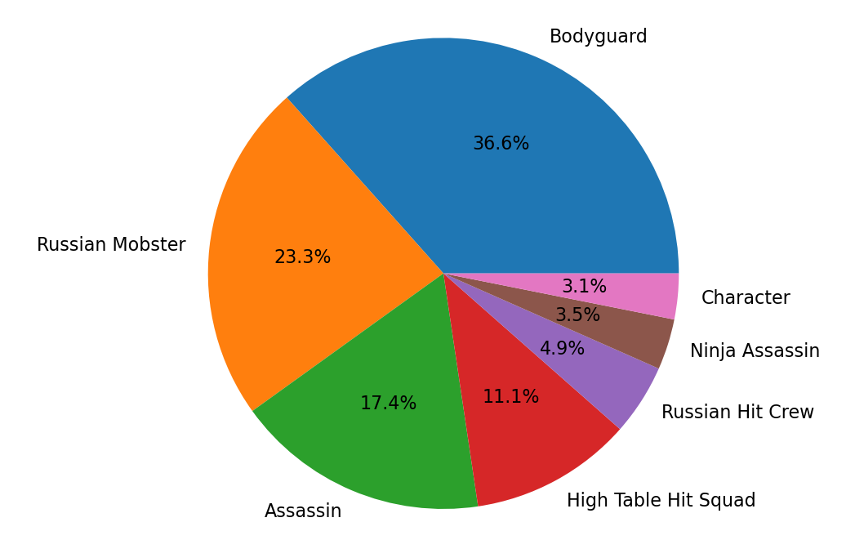
Who are the target/victims?

Slide 17
Thank you!

